Slide 1
Digital System
Chapter V.
Synchronous Sequential Logic
고려대학교
전기전자전파공학부
최 린

Slide 2
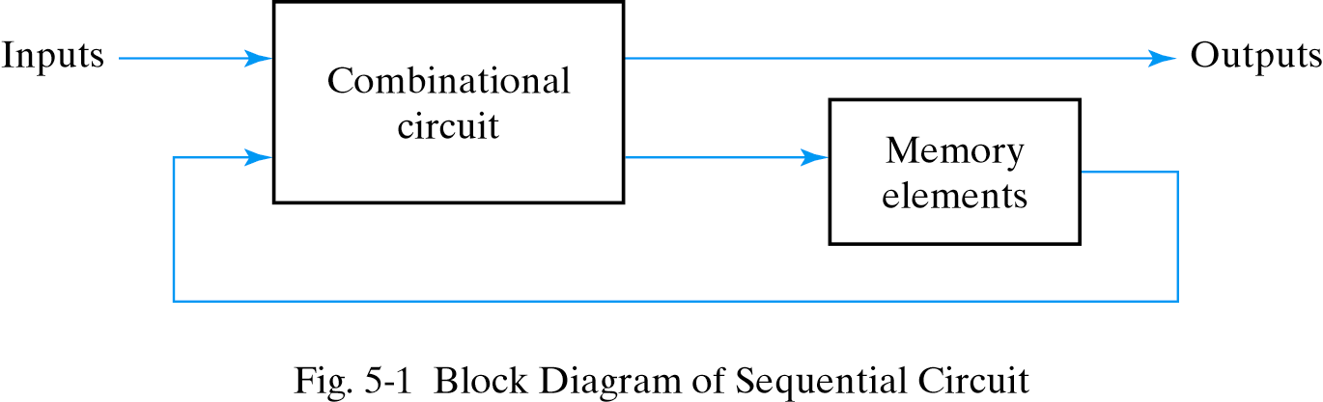



Definition
Sequential circuit
  Combinational circuit + storage elements
  Storage elements
    Store binary information
    Determine the state of the sequential circuit at any given time
    Can maintain a binary state indefinitely until directed by an input signal
    Basic storage elements: latches, flip-flops
  Outputs depend on its current inputs as well as its current state
    Ex: channel up-down pushbuttons on a remote control
  Outputs depend not only on its current input but also on the past sequence of inputs

Slide 3
Types of Sequential Circuits
Two types
  The behavior of sequential circuits depends on the timing of their signals.
Asynchronous sequential circuit
  Input signals can change at any instance of time
  The behavior of the asynchronous sequential circuit also depends on the order of the input signals changed
  In general, asynchronous circuits are difficult to design since their behavior is highly dependent on the propagation delays of the gates and on the timing of the input changes
Synchronous sequential circuit
  Input signals change at discrete instants of time, governed by a timing device called clock generator, which produce a periodic train of clock pulses
  Storage elements are affected only upon the arrival of each pulse
  Clock pulses are applied with other signals that specify the change in storage elements
  Synchronous sequential circuits that use clock pulses as inputs to storage elements are called clocked sequential circuits

Slide 4
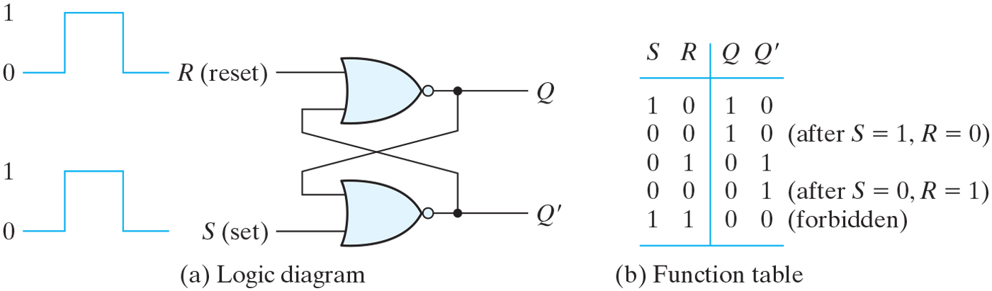

Latches
Latch
  The most basic type of storage element
  Can store one bit of information
  Usually provide two outputs: normal and complemented value
  Used within a flip-flop, which is the basic storage element used in clocked sequential circuits
SR latch
  A circuit with 2 cross-coupled NOR (or NAND) gates
  2 inputs: S (set) & R (reset)
    When inputs are applied, the next state depends on the inputs as well as on the present state

Slide 5
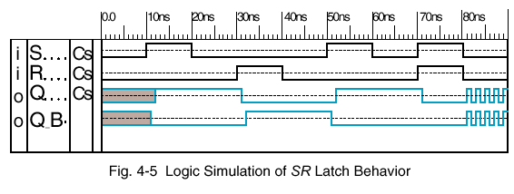
SR Latch
Forbidden state (S = R = 1)
  Violate the requirement that the outputs be the complement of each other
  Result in an undefined state when both inputs return to 0 simultaneously => Q and Q’ oscillating between 1 and 0 assuming simultaneous input changes and equal gate delays

Slide 6
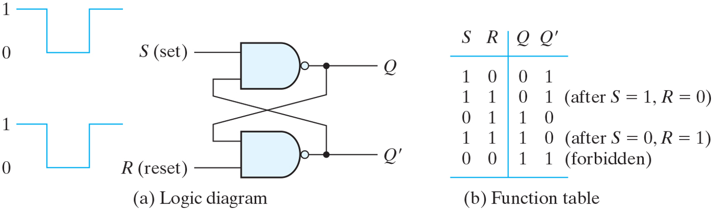
SR Latch
SR latch with NAND gates
  It operates with both inputs normally at 1, unless the state has to be changed.
  The input signals for the NAND require the complemented input.
    It is sometimes referred as an S’R’ latch since the input must be in its complemented form.
  Forbidden state (S = R = 0)

Slide 7
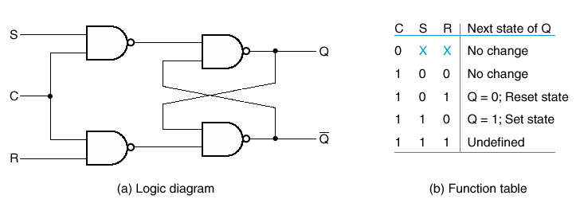
SR Latch with a Control Input
C (control input) acts as an enable signal
  If C=0, no change; If C=1, act as SR latch
Important building block since other latches and F/Fs are built from the SR latch with a control input
The indeterministic condition (S=R=1) is seldom used in practice

Slide 8
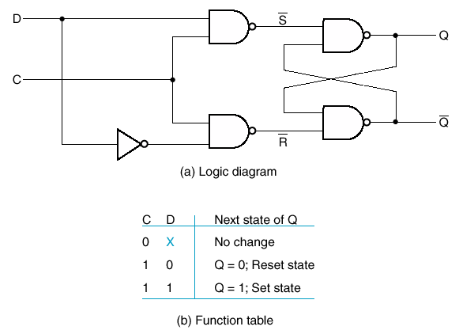
D Latch
Eliminate the undesirable state in the SR latch by connecting D’ to R input
  S & R can never be the same

Slide 9
Flip Flops
Latch
  As long as the control input remains active, any changes in the data input will change the state of the latch.
  In this sense, the latch is transparent, since its input value can be seen from the output.
When latches are used for storage element, a serious problem occurs
  The state transitions of the latches start as soon as the control (clock) input becomes high.
  The new state of a latch appears at the output while the control input is still active and this output is directly connected to the inputs of latches through a combinational circuit.
  If the inputs applied to the latches change while the control is still active, the latches will respond to new values and a new output state may occur.
  While the clock pulse is active, a succession of changes of state may occur, which results in an unpredictable situation.
  The final state depends on how long the clock pulse stays at level logic 1.
  To prevent this, the output of a latch must not be applied directly (or through combinational logic) to the input of the same or another latch when all the latches are triggered by a single clock signal.

Slide 10
Flip-Flops
Instead, we use flip-flops
  Basic storage elements employed in clocked sequential circuits
  Like latches, can store one bit of information and produce two outputs: normal and complemented values
  Flip-flop is nontransparent
    A FF cannot see the change of its output during the same clock pulse
    The transition from one state to the other occurs only at predetermined time intervals dictated by the clock pulses
    The state is allowed to switch by a momentary change of the clock signal (called a trigger or a signal transition).
    This can be accomplished by eliminating the feedback path from the output state to the input inherent in the latch.
Two types of flip-flops
  Master-slave FF: combines two latches
    The first latch is enabled during clock high
    The second latch is enabled during clock low
  Edge-triggered FF: triggers only during signal transition
    The problem with the latch is that it responds to a change in the level of a clock pulse.
    0 to 1 or 1 to 0 transition on the clock
    Disabled at all other times

Slide 11



Latch vs F/F
Latch : case (a), output changes as input changes as long as the enable input remains at the positive level
Flip-flop : output only changes at clock edge (signal transition)

Slide 12
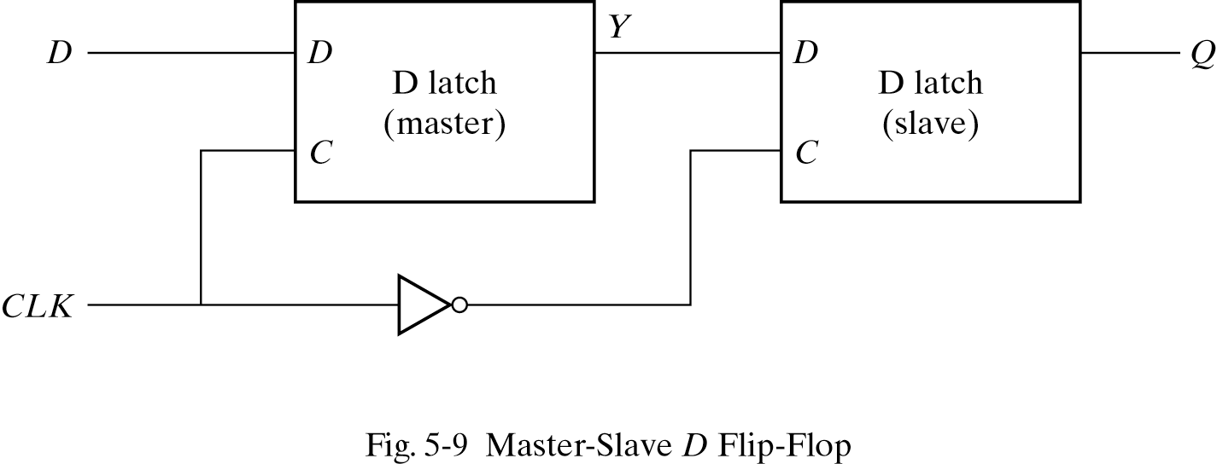
Master-Slave Flip-Flop
Master-Slave SR Flip-Flop
  When the clock input is 1, master is enabled, slave disabled
    Input D can change the master output Y (but not Q)
  When the clock input is 0, master disabled, slave enabled
    The value of output Q is the value that was stored in the master immediately before the negative edge occurred.
    Input D can change anytime, which does not affect master
  The behavior of master-slave flip-flop dictates that the output may change only during the negative edge of the clock.

Slide 13
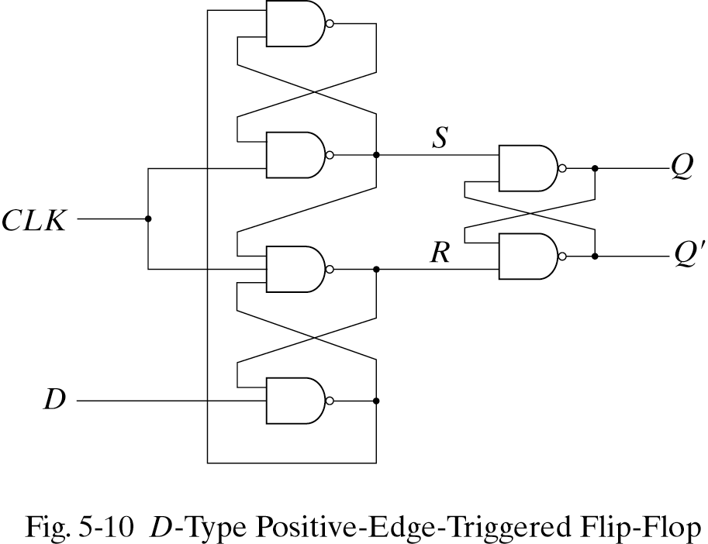


Edge-Triggered Flip-Flops
Edge-triggered flip-flop: use 3 SR latches
  If CLK = 0, S = R = 1, which causes the output to remain its present state
  If D = 0
    When CLK becomes 1, R =0, which causes the F/F to go to the reset state
    If there is a change in the D while CLK = 1, R remains at 0.
  If D = 1
    When CLK becomes 1, S =0, which causes the F/F to go to the set state
    If there is a change in the D while CLK = 1, S remains at 0.
D-type positive-edge triggered FF
  Q changes only when CLK becomes 0 to 1
  Ignore the pulse while it is at a constant level, but triggers only during the 0 to 1 transition of the clock signal
1
2
5
3
6
4

Slide 14
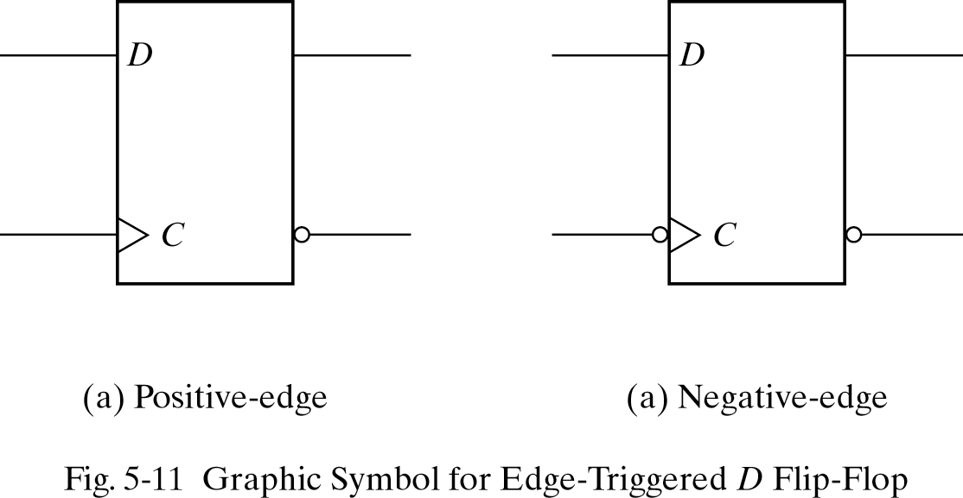
Timing of a Flip-Flop
The edge-triggered D flip-flop has a setup time and hold time window during which the D input must not change
  Setup time: a minimum time for which the D input must be maintained at a constant value prior to the occurrence of the clock transition
  Hold time: a minimum time for which the D input must not change after the application of the positive transition of the pulse
  Propagation delay time: the interval between the trigger edge and the stabilization of the output to the new state

Slide 15
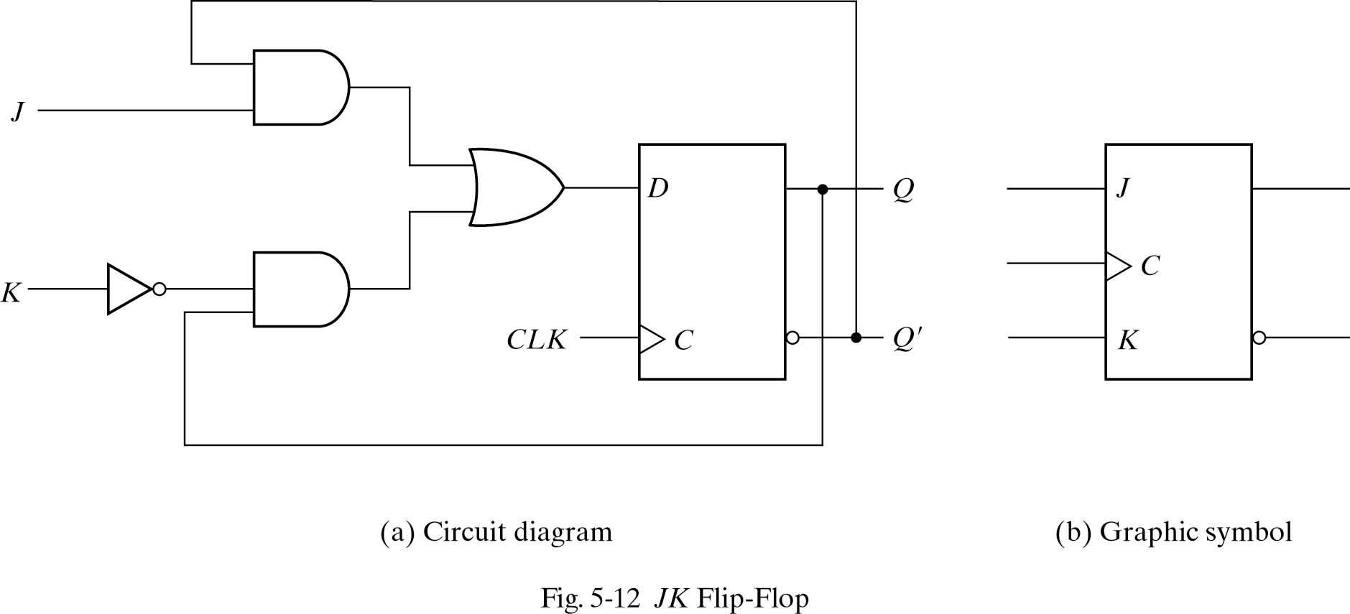
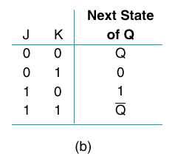
JK Flip-Flop
Positive-Edge-Triggered JK Flip-Flop
  D = JQ’ + K’Q

Slide 16
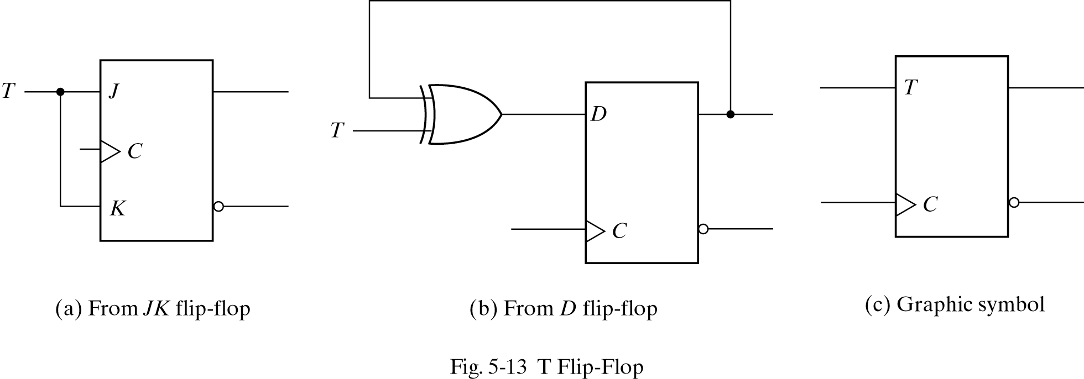
T Flip Flop
Positive-Edge-Triggered T Flip-Flop
  D = TQ’ + T’Q

Slide 17
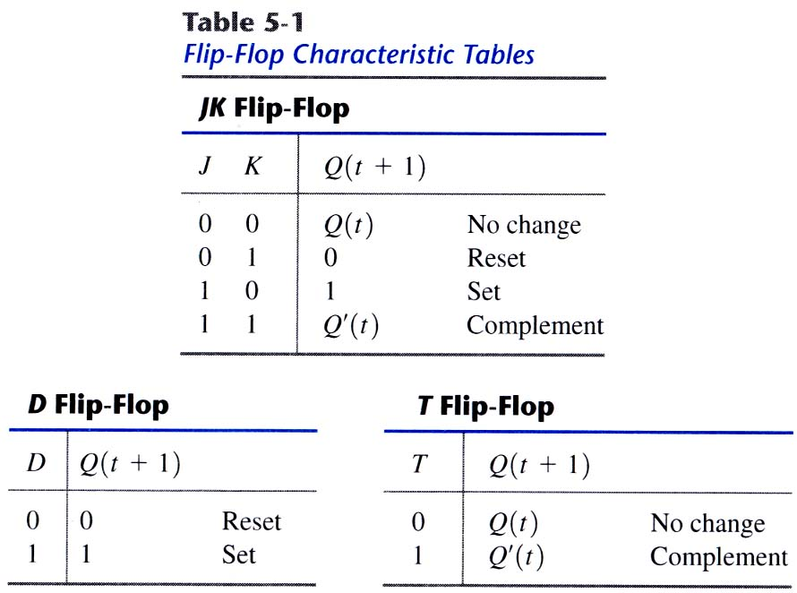
Characteristic Tables
Characteristic Tables
  Logical properties of a flip-flop in tabular form
  Define the next state as a function of the inputs and present state

Slide 18
Characteristic Equations
The logical properties of a flip-flop in the characteristic table can be expressed also algebraically with a characteristic equation.
D flip-flop
  Q(t+1) = D
JK flip-flop
  Q(t+1) = JQ’+K’Q
T flip-flop
  Q(t+1) = TQ’+T’Q

Slide 19
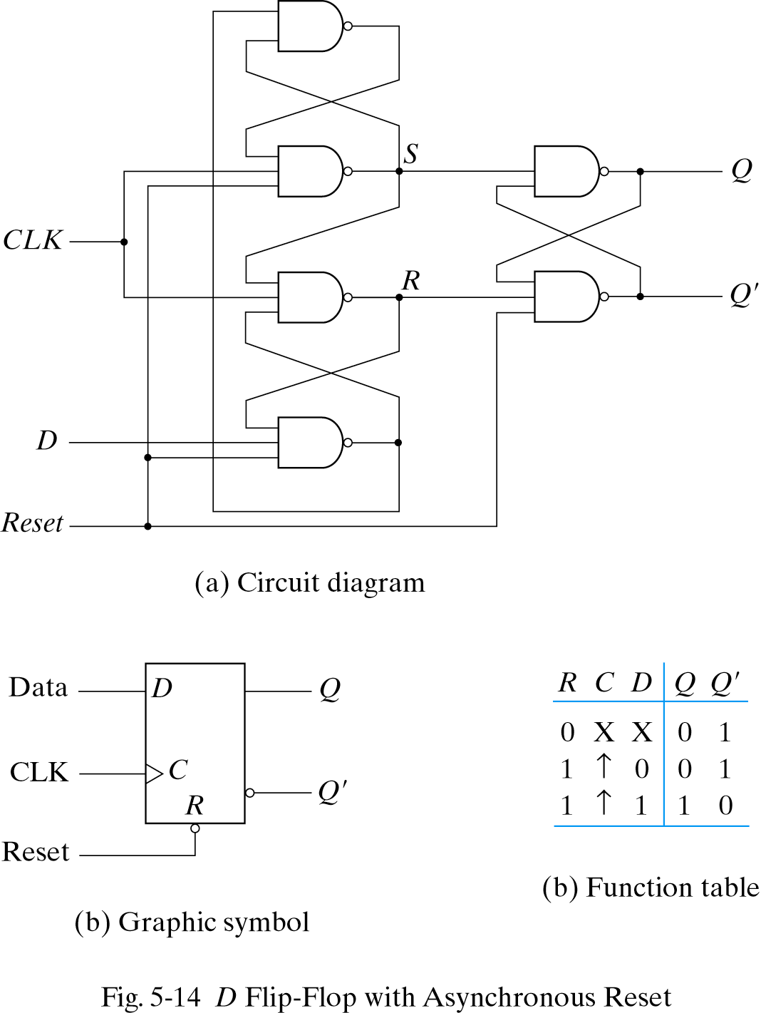
Flip-Flops
Direct (asynchronous) inputs
  Flip-flops often provide special inputs for setting and resetting them asynchronously, i.e. independent of the clock input C.
    The inputs that asynchronously set the flip-flop are called direct set, or preset.
    The direct inputs are useful for bringing all flip-flops in a digital system to an initial state prior to the normal clocked operation.
D flip-flop with asynchronous reset

Slide 20
Sequential Circuit Analysis
Sequential circuit analysis
  Behavior of a sequential circuit is determined from inputs, outputs, present and next states of the circuit
  Outputs & the next state are function of inputs & present state
Sequential circuit can be specified by
  A logic diagram
    A logic diagram of sequential circuit includes FFs (any type) and usually combinational gates.
    The flip-flops may be of any type, and the logic diagram may or may not include combinational gates.
  Algebraic representation
    The knowledge of the type of flip-flops used and a list of Boolean functions for the combinational circuit provide all the information needed to draw the logic diagram of the sequential circuit
  State table
    Consists of 4 sections: present state, input, next state, output
  State diagram
    The information in a state table can be represented graphically by a state diagram

Slide 21

Algebraic Representation
  The knowledge of the type of flip-flops used and a list of Boolean functions for the combinational circuit provide all the information needed to draw the logic diagram of the sequential circuit
    Boolean functions for the inputs of the flip-flops
    Boolean functions for the outputs
Input equations for the flip-flops
  An algebraic expression to specify the logic diagram of a sequential circuit
    Imply the type of FF used
    Specify the combinational circuit that drives the FF
    Boolean functions for flip-flops
      The part of the combinational circuit that generates the signals for the inputs of flip-flops can be described by a set of Boolean functions, flip-flop input equations
Output equations
  Boolean functions for outputs

Slide 22
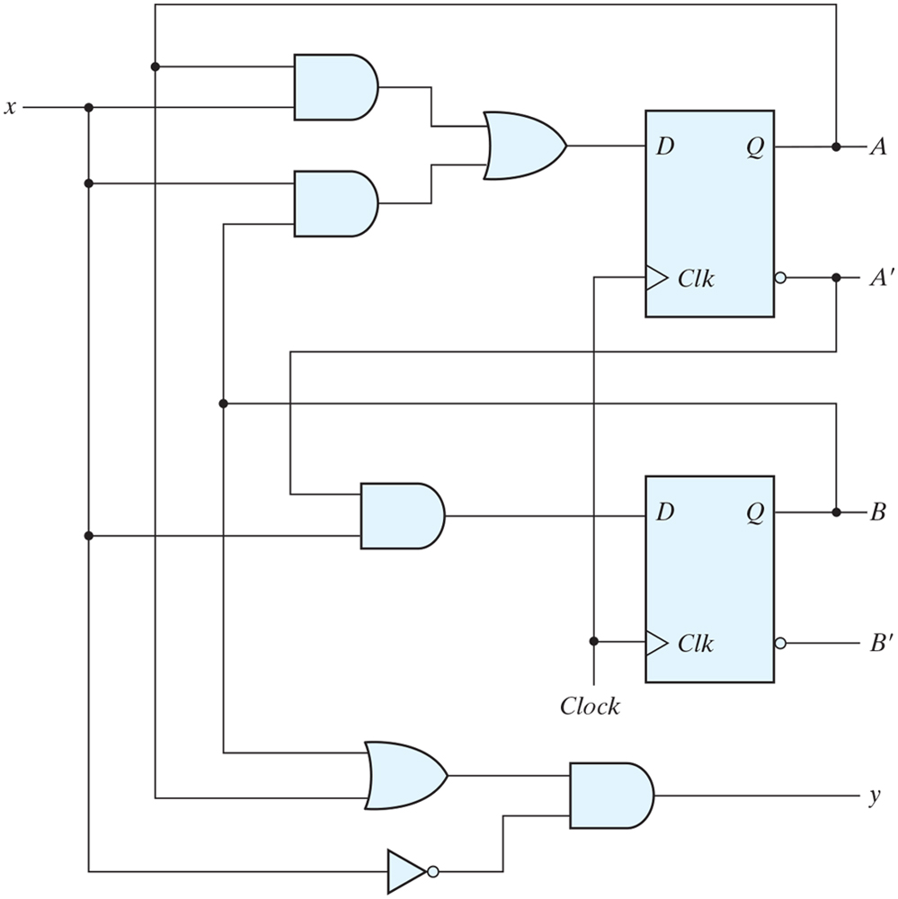
Algebraic Representation: Example
  D_{A} = AX + BX, D_{B} = A'X (input equations for the flip-flops)
  A(t+1) = AX + BX, B(t+1) = A’X (state equations)
  Y = (A+B) X' (output equations)

Slide 23



State Table
State table
  Specifies the behavior of a sequential circuit
  Consists of 4 sections: present state, input, next state, output
    Output is a function of present states and inputs at time t
    Next state is a function of present states and inputs at time t+1
  In general, a sequential circuit with m flip-flops and n inputs need 2^{m+n} rows in the state table.
Derivation of state table
  List all possible combinations of present states and inputs
  The next state values are determined from the logic diagram or from the flip-flop input equations
    For D flip-flops, the next state of flip-flop A is equal to the present value of its input D (i.e. input equation)
    For the example
      A(t+1) = D_{A} = AX + BX
      B(t+1) = D_{B} = A'X
  The output values are derived from the output equations
      Y = (A+B) X‘

Slide 24
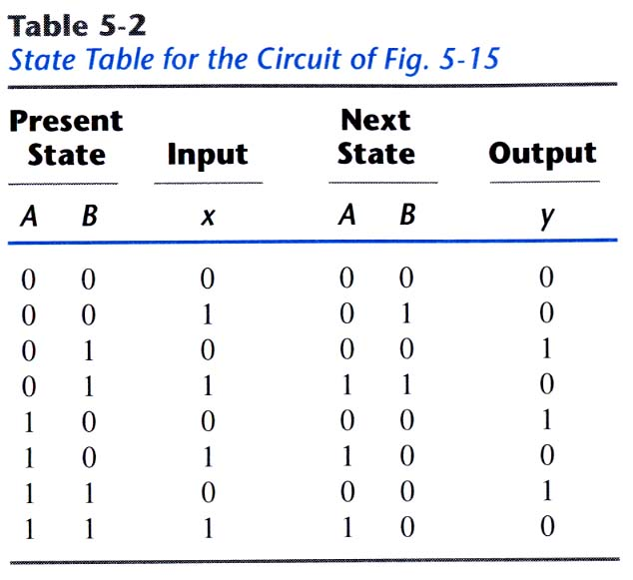
State Table: Example
D_{A} = AX + BX
D_{B} = A'X
      Y = (A+B) X‘

Slide 25
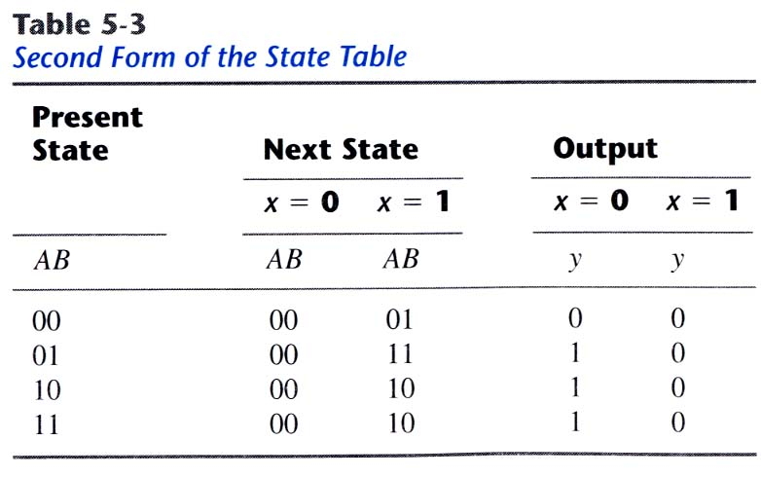
State Table
  Table 5-2 is one-dimensional in the sense that the present state and input combinations are combined into a single column of combinations.
Two-dimensional state table

Slide 26
State Diagram
State diagram
  The information in a state table can be represented graphically by a state diagram
  A pictorial view of state transitions
  A state is represented by a circle and transitions between states are indicated by directed lines connecting the circles.
State table versus state diagram
  State table is easier to derive from a given logic diagram or input equations
  State diagram is more suitable for human interpretation of the operation of the circuit

Slide 27
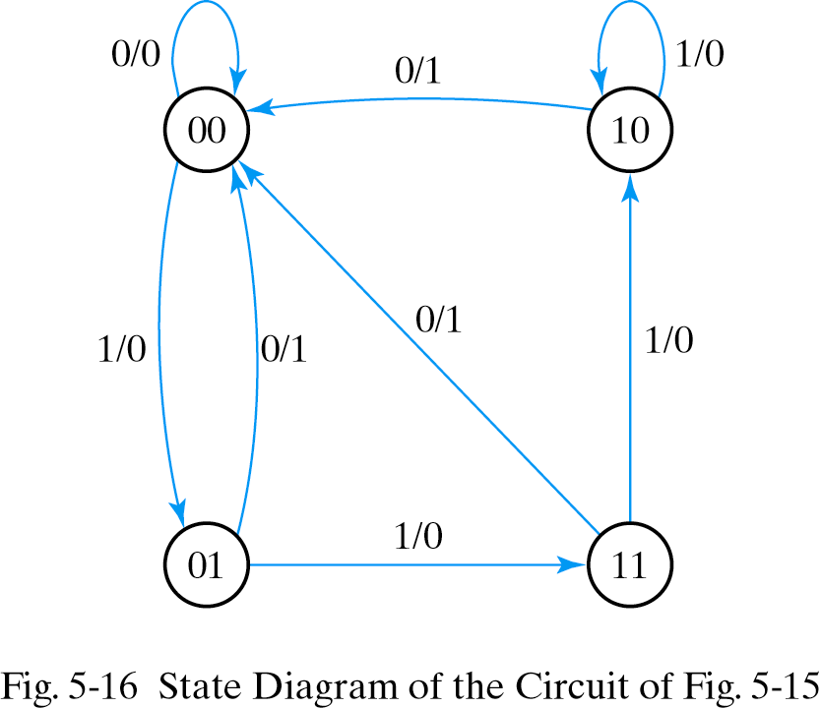
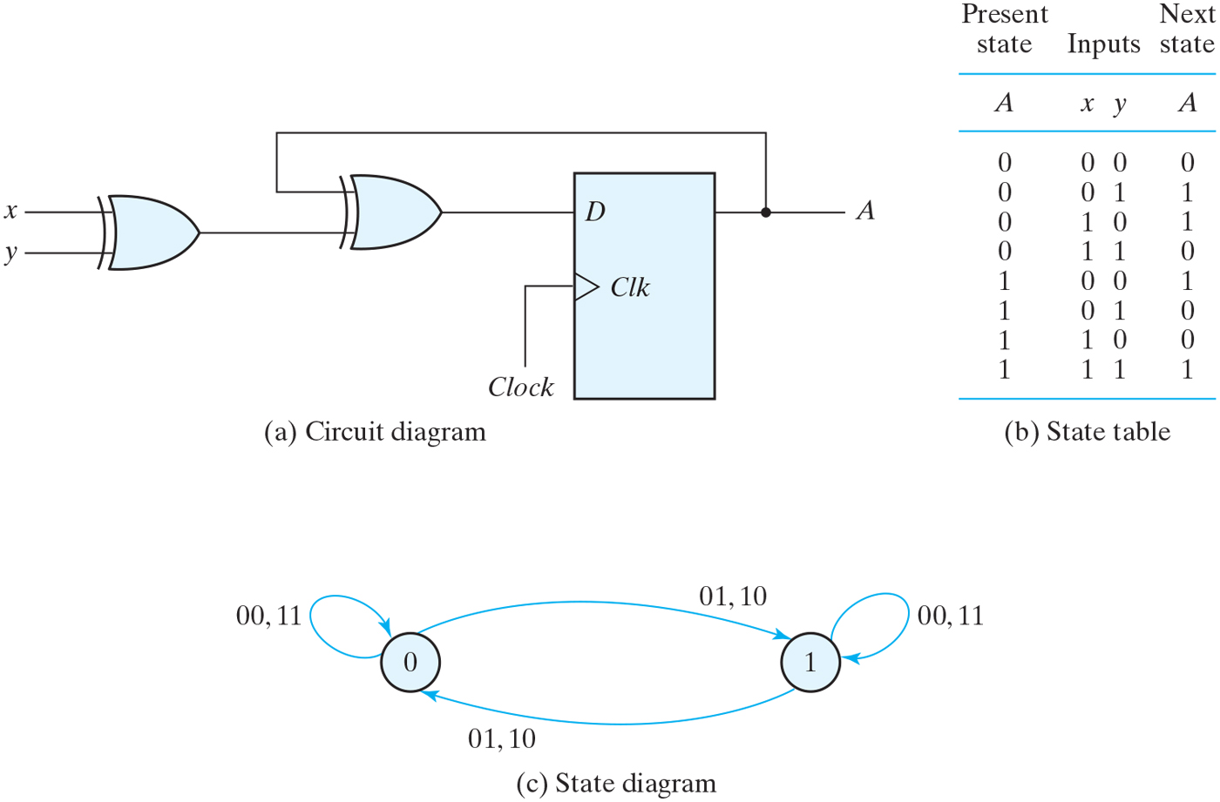
State Diagram: Example
State diagram for Fig 5-15
- Mealy machine
- Outputs depend on inputs and states
Sequential circuit with D F/F
- Moore machine
- Outputs depend on the states

Slide 28
Sequential Circuit Models
Circuit Models
  Mealy model
    The outputs depend on the inputs and the states
    (+) Tend to have fewer states
    (+) React faster to inputs (react in the same cycle)
      (-) Outputs may change if the inputs change. Due to the delay, outputs must be sampled immediately before the clock transition.
  Moore model
    Outputs depend only on the states
      Outputs are synchronized with the clock
      Outputs change one cycle later than inputs
    (+) Safer to use
Analysis Procedure
  Circuit diagram => Equations => State table => State diagram

Slide 29
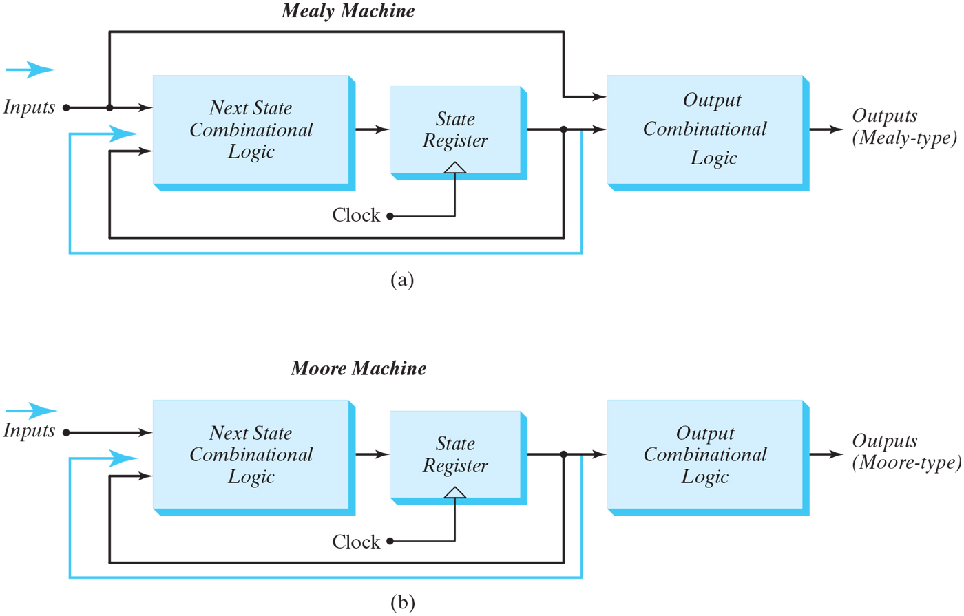
Mealy vs Moore Machines
Figure 5.21
Block diagrams of Mealy and Moore state machines.

Slide 30
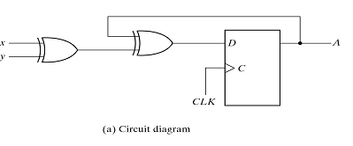
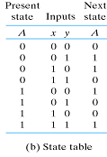
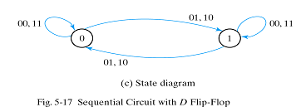
Analysis with D Flip-Flops
Example of a Moore Model
  Input equation : D_{A} = A ⊕ x ⊕ y
  No output equations are given.
  State equation is given by A(t + 1) = A ⊕ x ⊕ y
  The state diagram has two circles, one for each state.

Slide 31
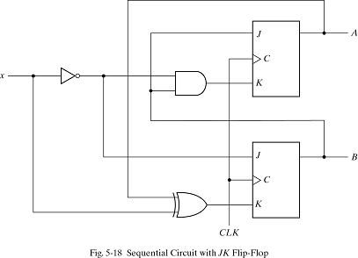
Analysis with JK Flip-Flops
Next state values are obtained by a 2 step procedure:
  Obtain the binary values of each F-F input equation in terms of the present state & input variables
  Use the corresponding F-F characteristic table to determine the next state
A sequential circuit with 2 JK flip-flops with the following input equations
  J_{A} = B, K_{a} = B'X
  J_{B} = X', K_{b} = AX' + A'X

Slide 32
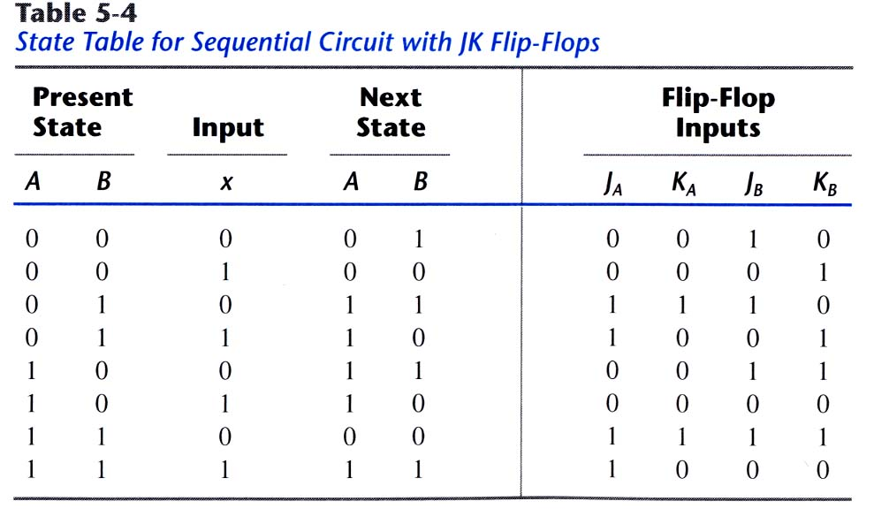
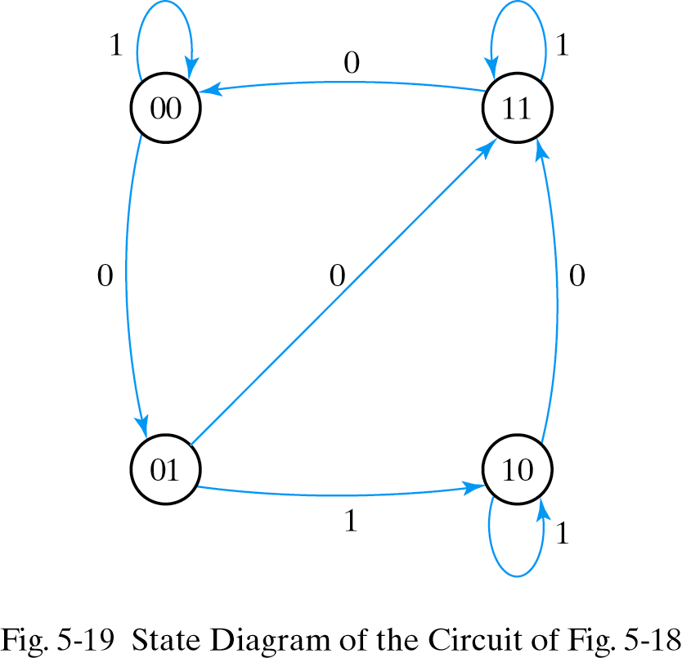
Analysis with JK Flip-Flop
State table and state diagram

Slide 33
State Reduction
State reduction is used to reduce the number of flip-flops, while keeping the external input-output requirements unchanged
  Since m F/Fs produce 2^{m} states, a reduction in the number of states may (or may not) result in a reduction in the number of F/Fs.
  The equivalent circuit (with fewer F/Fs) may require more combinational gates.
Equivalent circuit
  Only input/output sequences are important
    There are an infinite number of input sequences that may be applied to the circuit
    Each sequence results in a unique output sequence
  If identical input sequences are applied to the two circuits and identical outputs occur for all input sequences, then the two circuits are said to be equivalent
State reduction algorithm
  Two states are equivalent if, for each member of the set of inputs, they give exactly the same output and send the circuit either to the same state or to an equivalent state.
  When two states are equivalent, one of them can be removed without altering the input-output relationships. The removed state is replaced by the equivalent state.

Slide 34
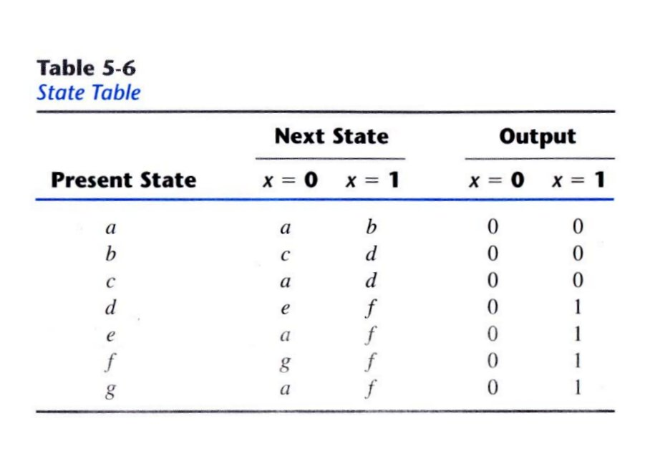
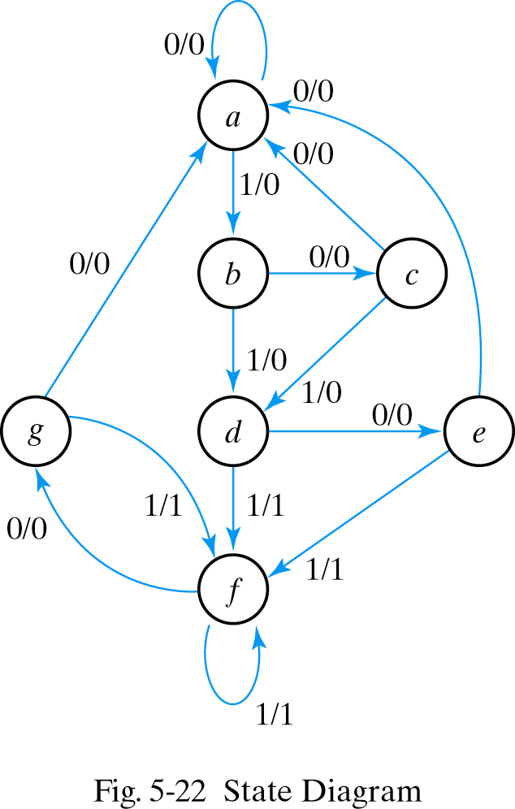
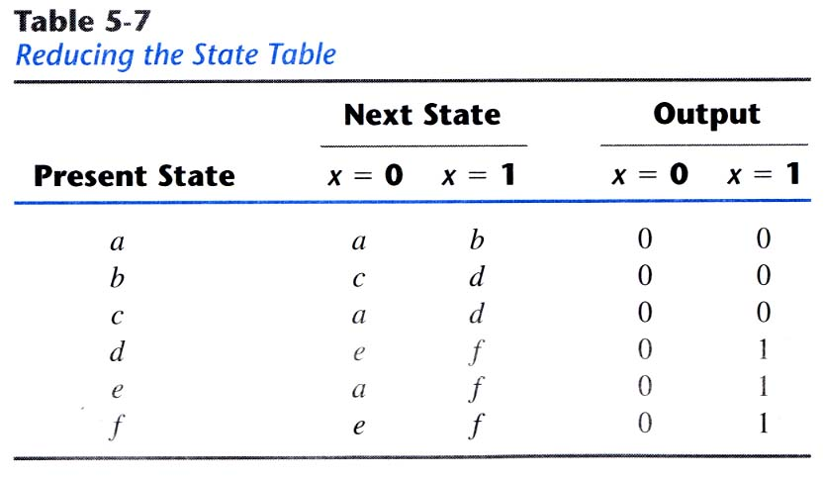
Example

Slide 35
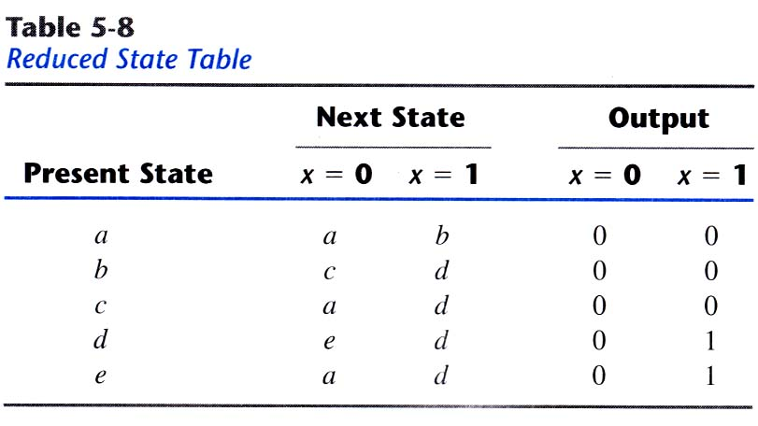
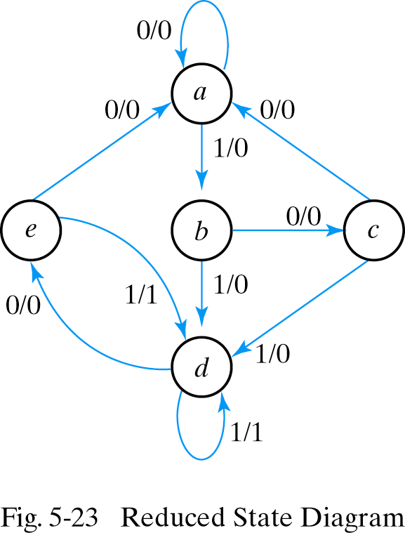
Example
Example
  Fig. 5.22: Consider the input sequence 01010110100
    State a a b c d e f f g f g a
    Input 0 1 0 1 0 1 1 0 1 0 0
    Output 0 0 0 0 0 1 1 0 1 0 0
  The new input-output sequence for the reduced state stable
    State a a b c d e d d e d e a
    Input 0 1 0 1 0 1 1 0 1 0 0
    Output 0 0 0 0 0 1 1 0 1 0 0
  7 states have been reduced to 5 states, but no savings in the HW

Slide 36
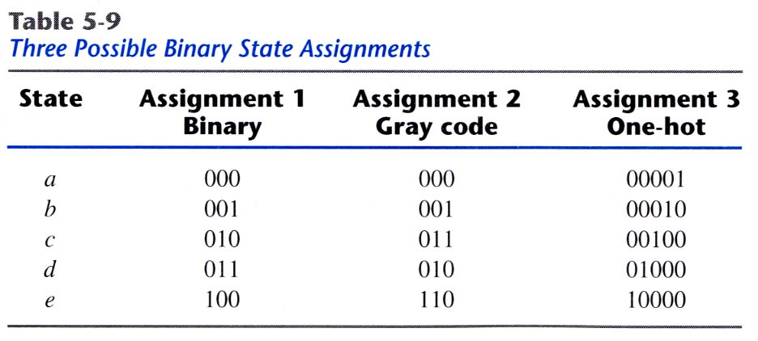
State Assignment
The job of assigning coded binary values to the states
For the example
  Need at least 3 bits (F/Fs) to denote 5 states
  The unused states (3 states) are treated as don’t care conditions
  It is more likely that the circuit with fewer states will require fewer combinational gates than the one with seven states
For a circuit with m states, codes must contain n bits where 2ⁿ≥m
Several possible binary state assignments

Slide 37
Sequential Circuit Design
Sequential circuit design procedure
  1) Specify the problem
  2) Derive the state diagram for the circuit
  3) Reduce the number of states
  4) Assign binary values to the states
  5) Derive the state table
  - Determine inputs, present states, next states, outputs
  - Assign binary codes to the states
  6) Determine the type & the number of FFs to be used
  - No. of FFs is determined from the no. of states (up to 2^{n})
  7) Derive FF input equations and output equations. Then, simplify
  8) Draw the logic diagram

Slide 38
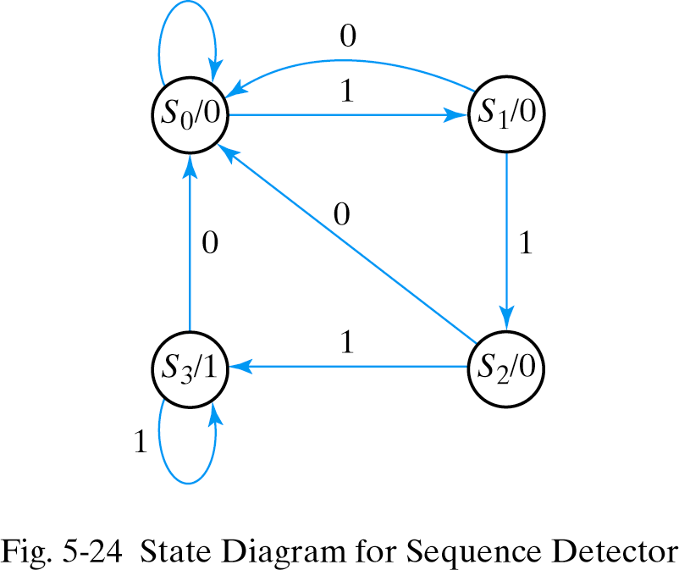
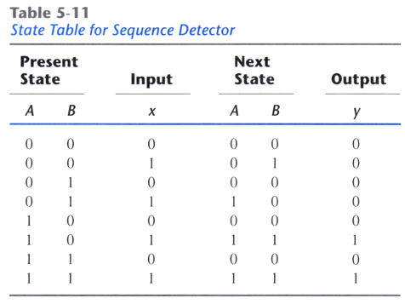
Example
Sequence Detector
  Description: The circuit detects three or more consecutive 1’s in an input string

Slide 39
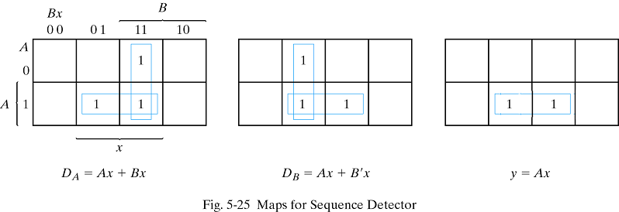
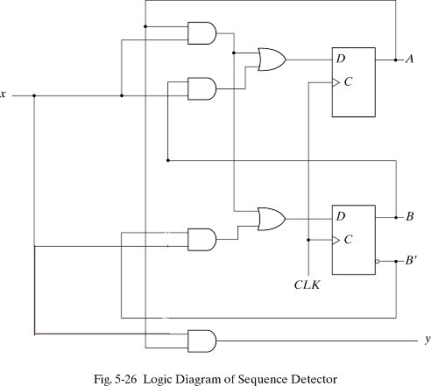
Design with D Flip-Flops
The design with D flip-flops
  The input equations are obtained directly from the next state.
    This is not the case for JK and T flip-flops.

Slide 40
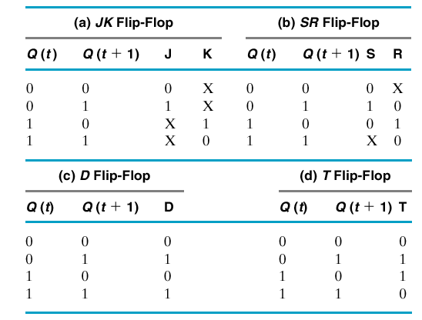
Design with JK and T Flip-Flops
Input equations must be evaluated from the present state to next state transition derived from the excitation table
Excitation table
  Specify the present state Q(t), the next state Q(t+1), and flip-flop input required for the state transition

Slide 41
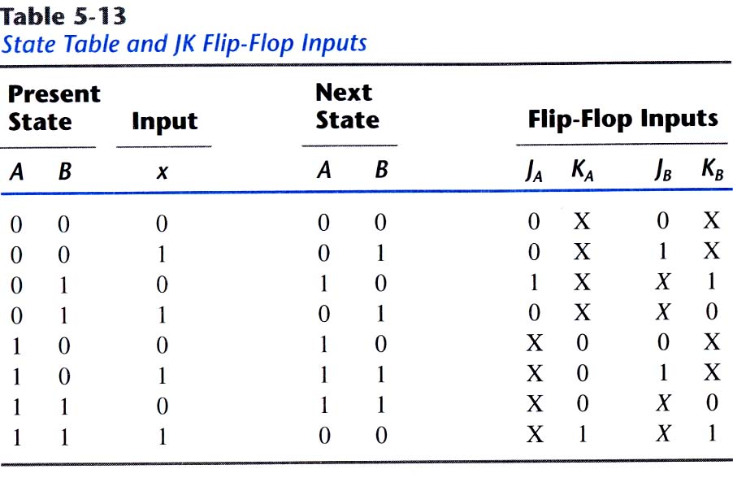
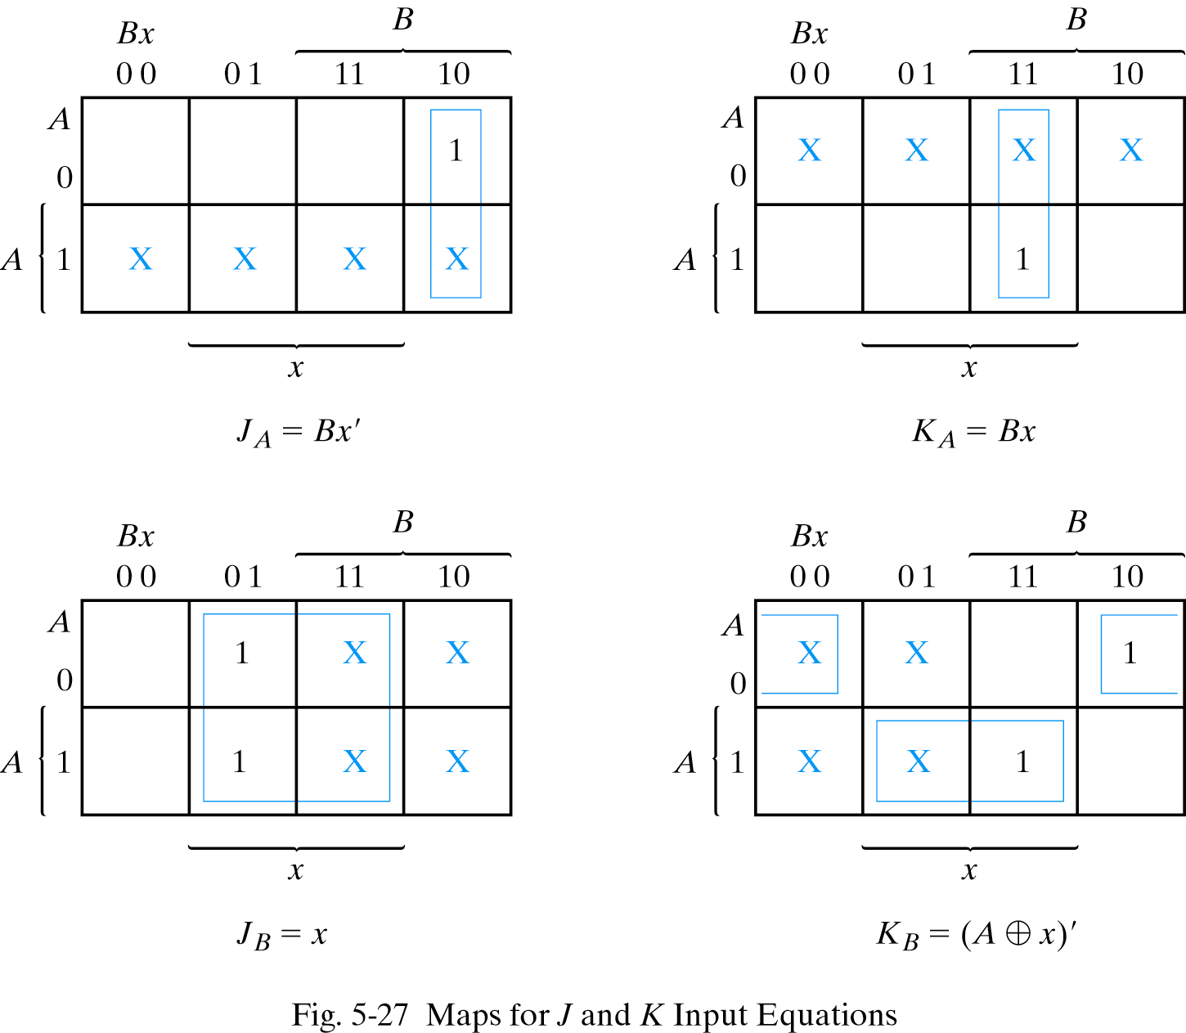
Design with JK Flip-Flops

Slide 42
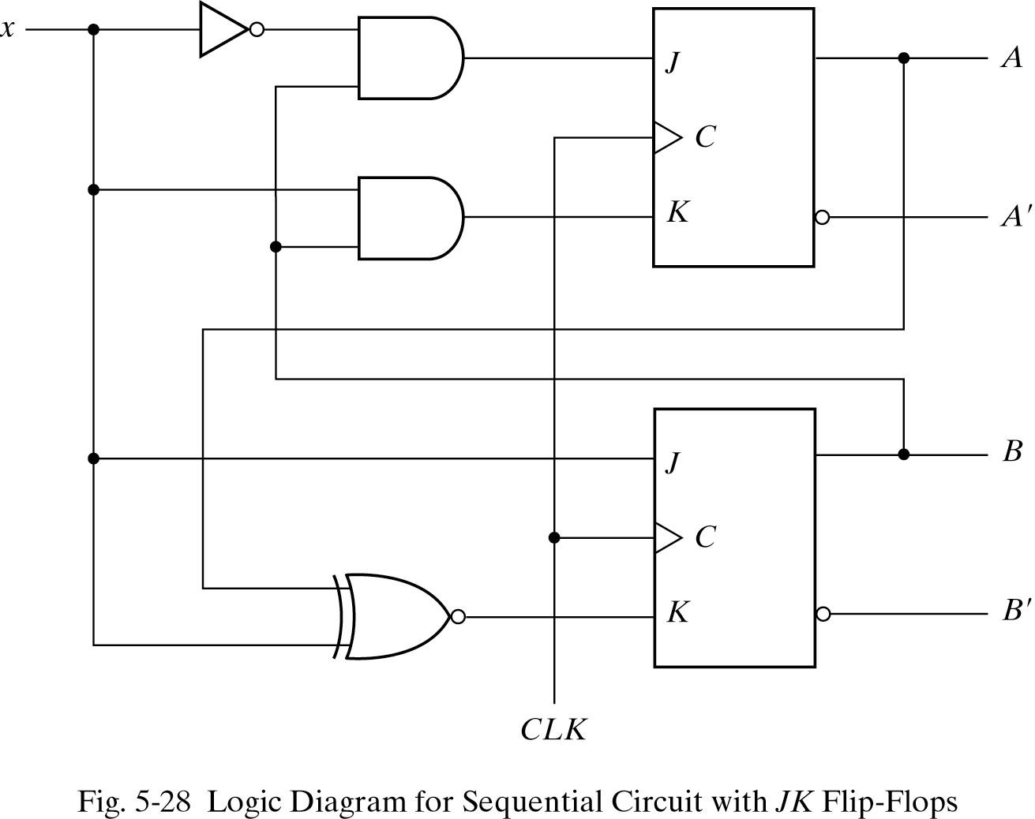
Design with JK Flip-Flops

Slide 43
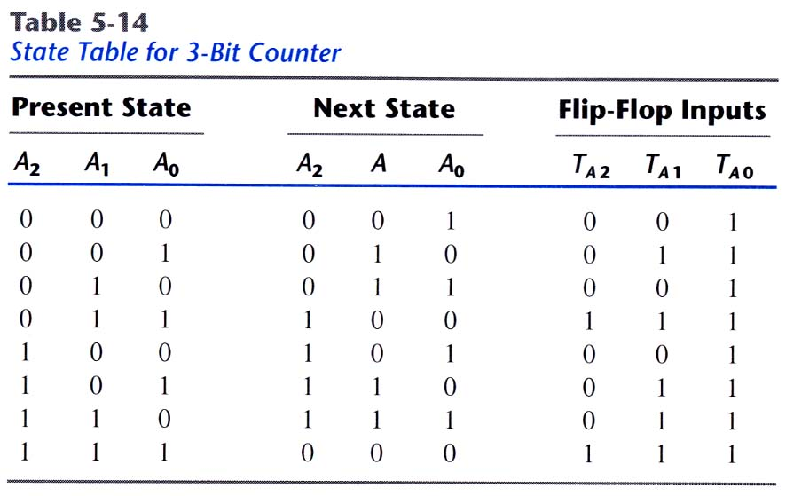
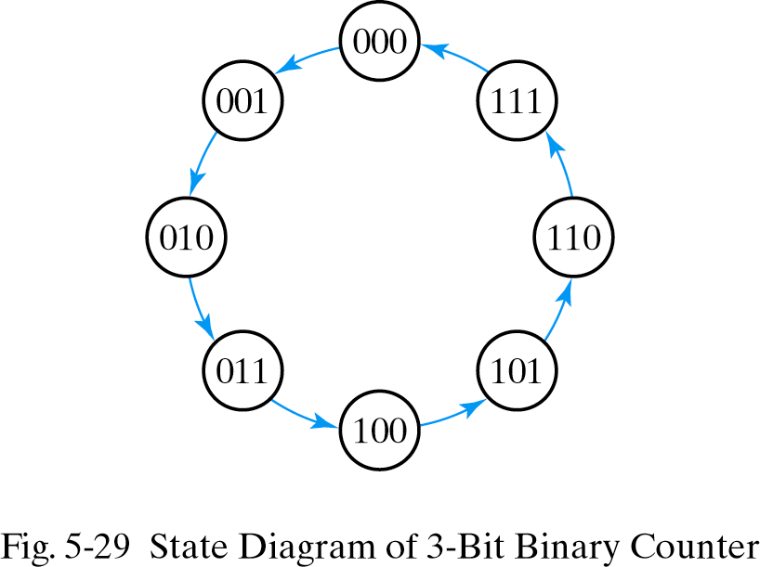
Design with T Flip-Flops
Example: 3-bit binary counter
  3-bit counter has 3 flip-flops and can count from 0 to 2ⁿ-1(n=3)

Slide 44
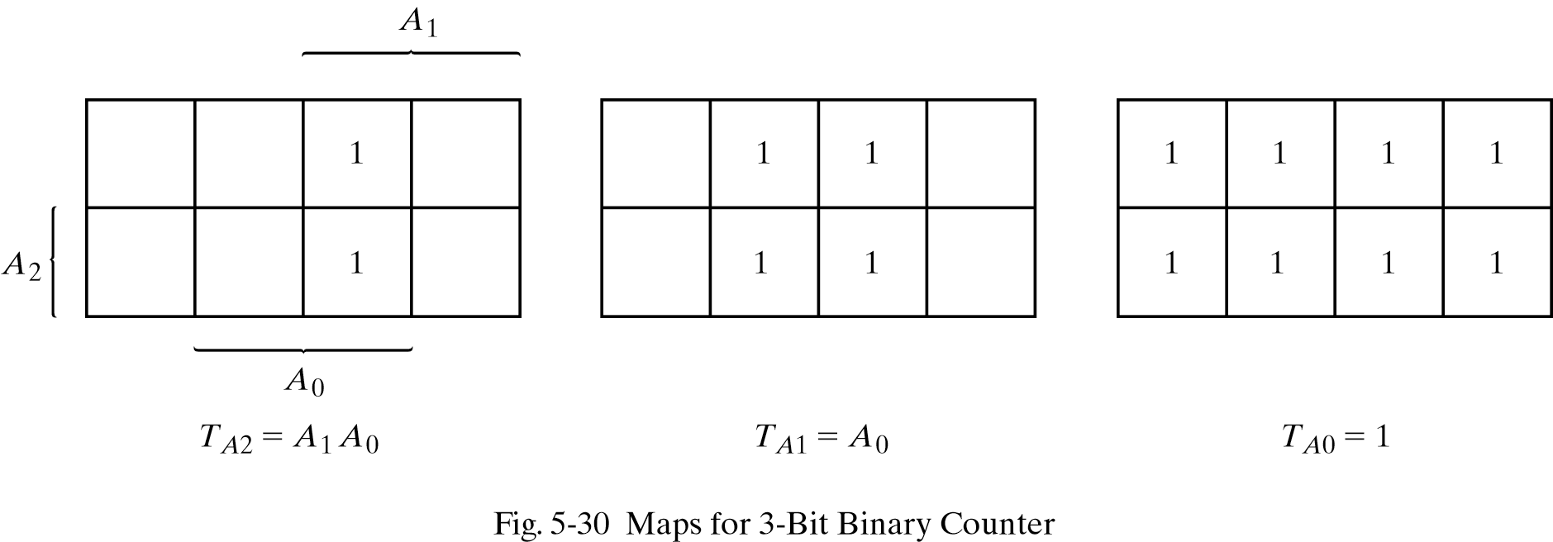
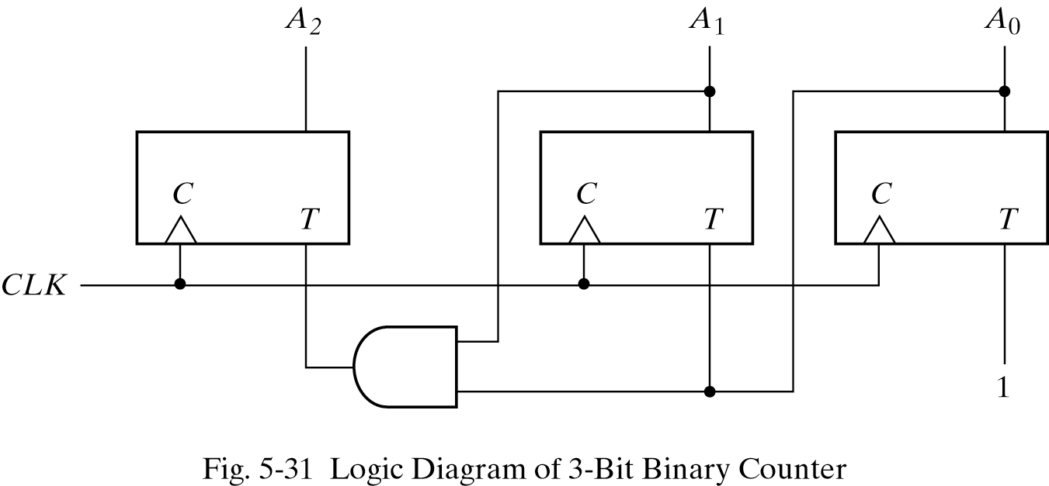
Design with T Flip-Flops

Slide 45
Homework V
Read Chapter 6.
PROBLEMS
  5.1
  5.3
  5.5
  5.7
  5.9
  5.12
  5.16
  5.20

